Slide 1







REAL-TIME FIRE DETECTION SYSTEM
AI-POWERED EARLY FIRE WARNING USING YOLOV8 + CCTV
Presented By
Santosh Bhandari
Sudhir Dahal

Slide 2
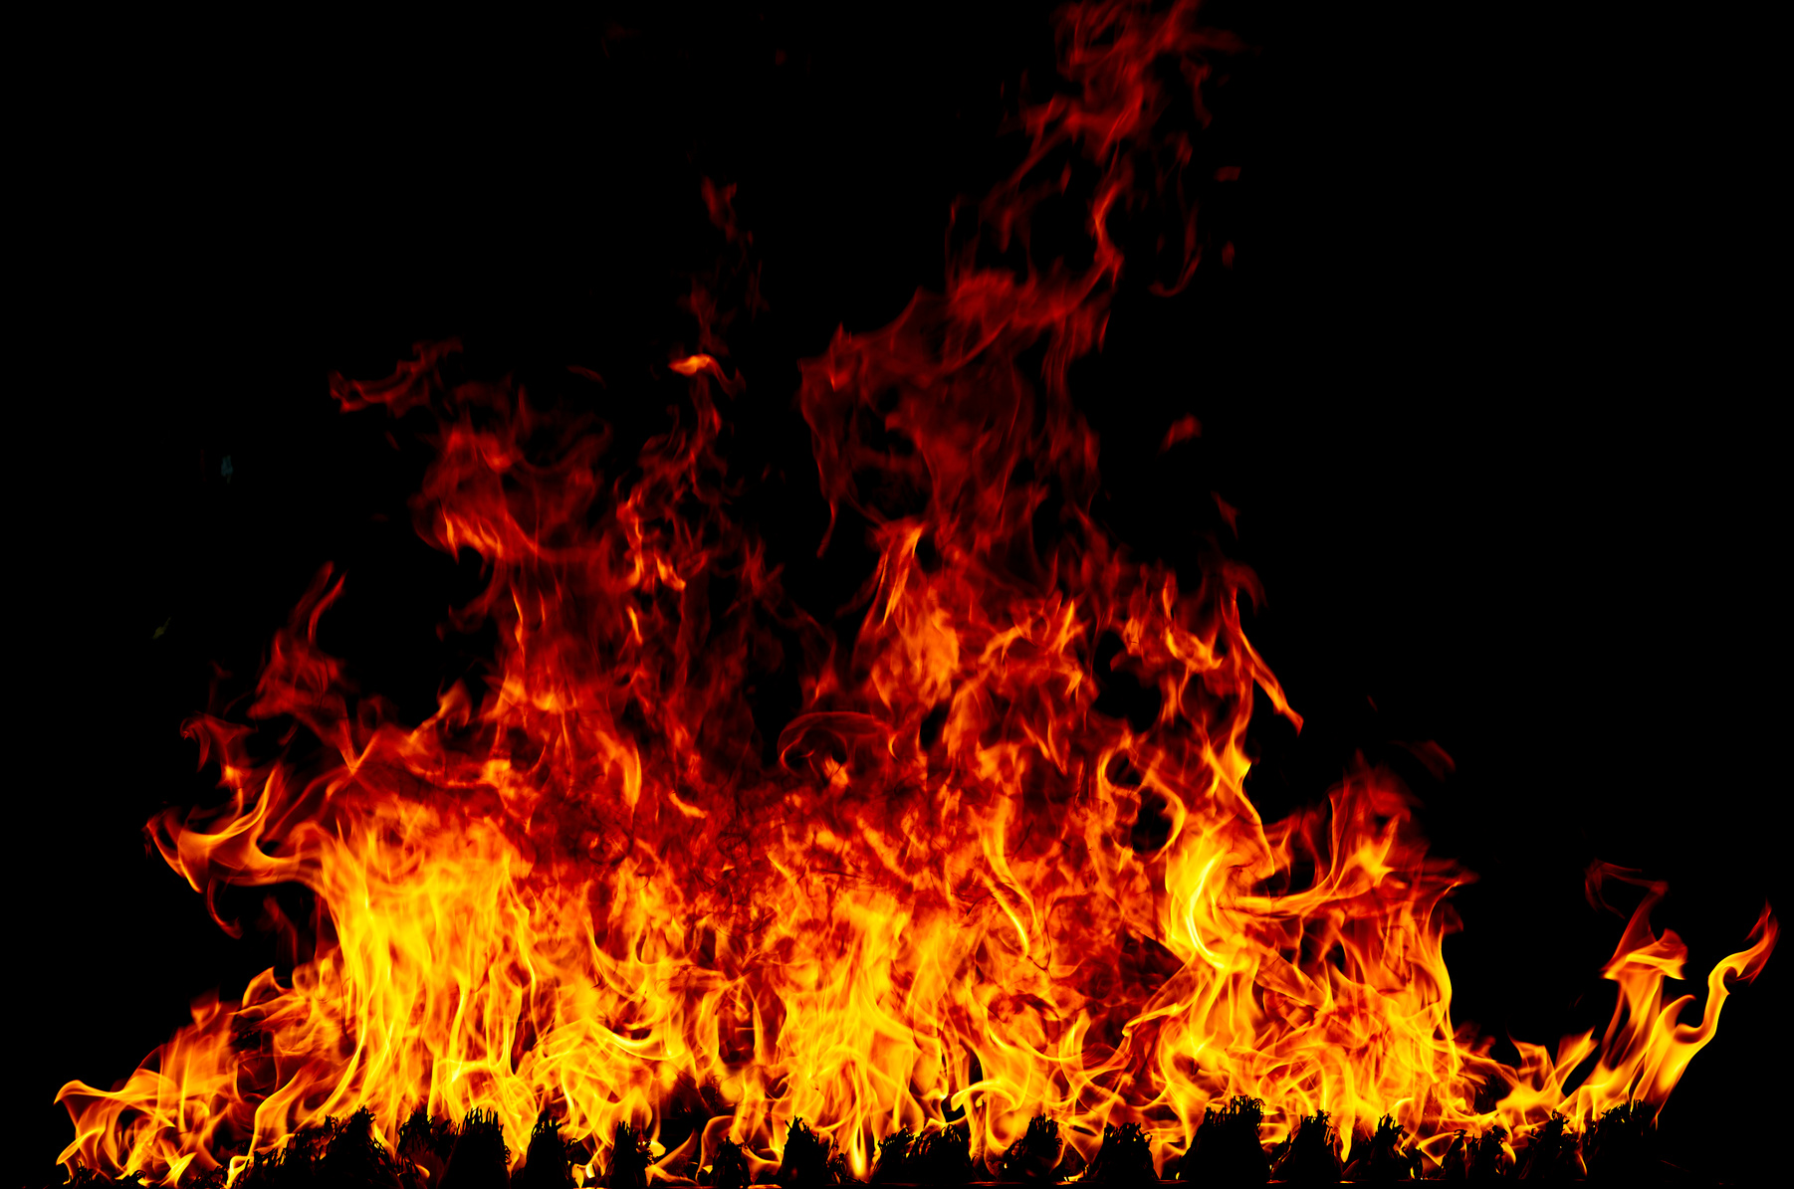
PROBLEM STATEMENT
Fire incidents cause massive losses every year.
Most damage occurs due to delayed detection and response.
Current detection systems rely on heat sensors and smoke detectors, which often detect fire too late.

Slide 3

OBJECTIVE
Detect fire automatically in real-time.
Send instant alerts to users.
Provide a dashboard for monitoring and alert management.
Make the system scalable and cost-effective.

Slide 4


SYSTEM OVERVIEW

Slide 5
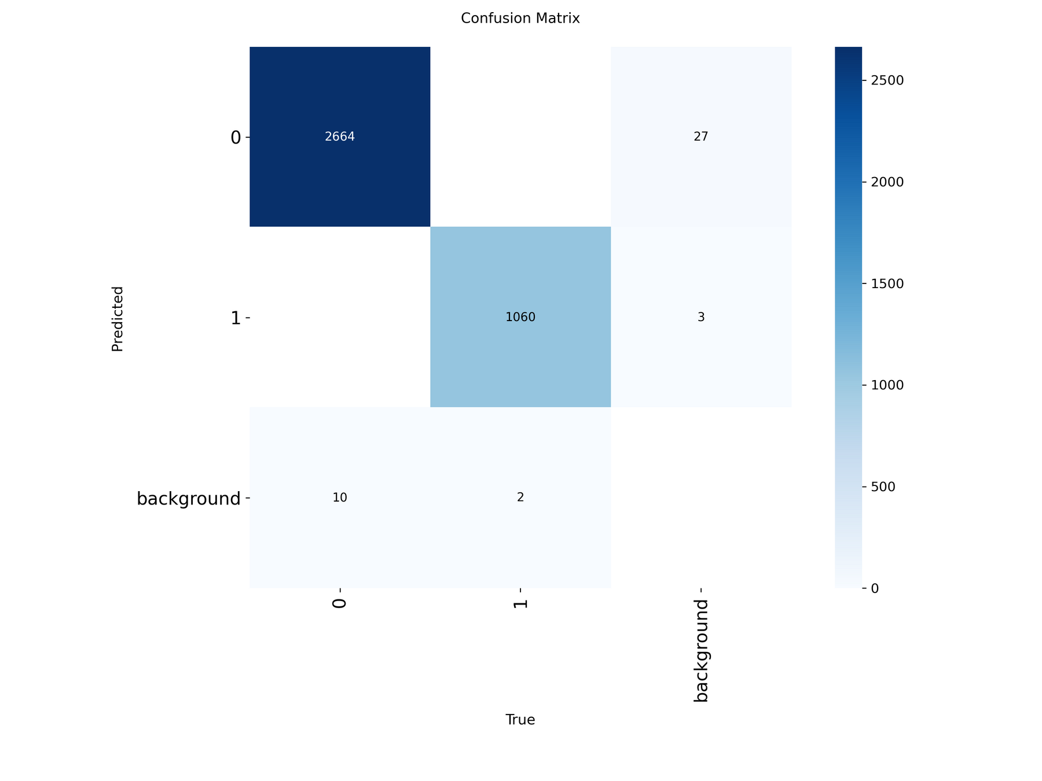

Slide 6
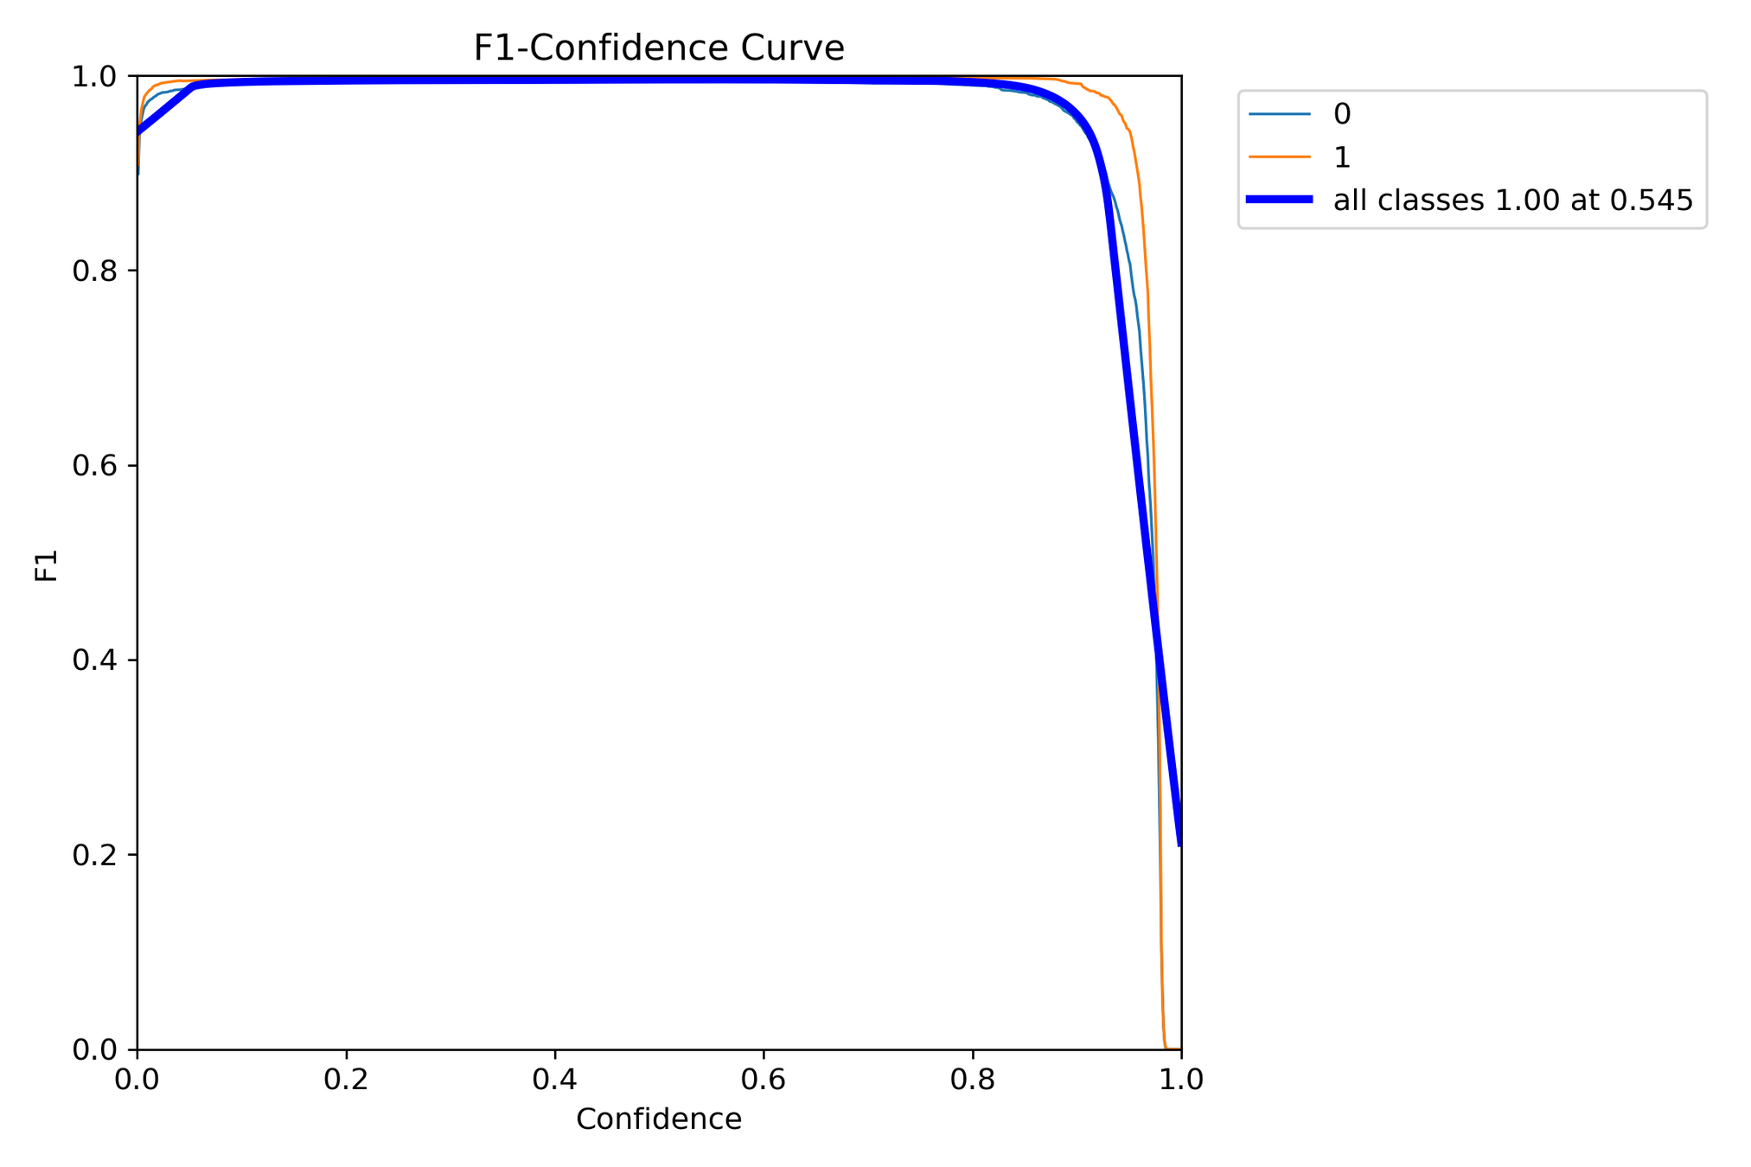

Slide 7
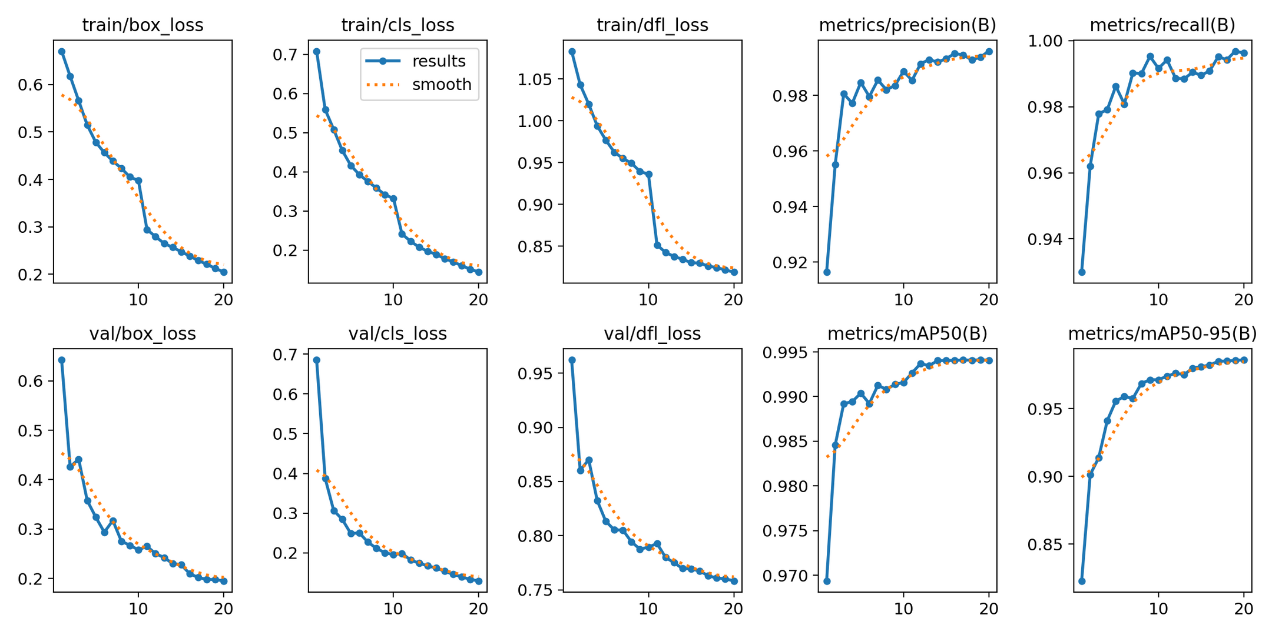

Slide 8
THANK YOU

